Slide 1
How To Raise Market Broilers in your Garage
Allen FFA

Slide 2
Set Up

Slide 3
Day 1

Slide 4
Day 1

Slide 5
Week 2-3

Slide 6
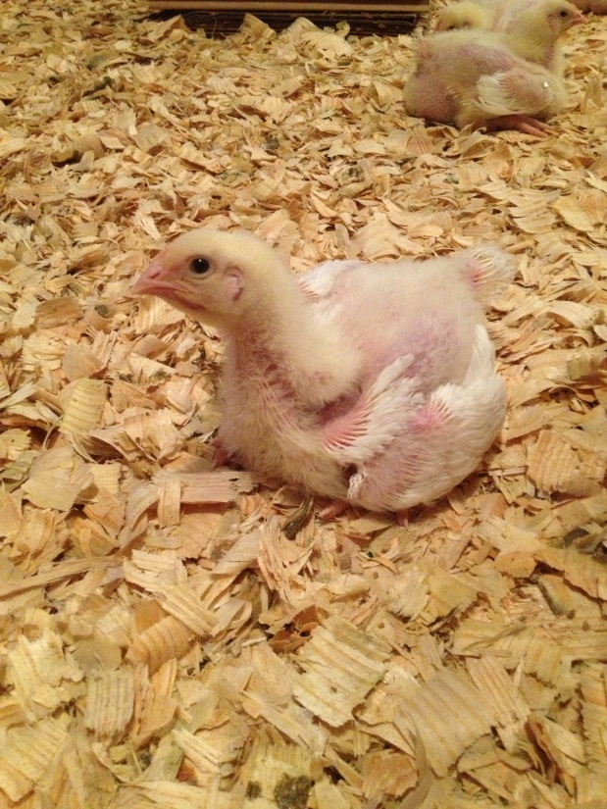
Week 3

Slide 7
Week 4-5

Slide 8
Week 5-6

Slide 9
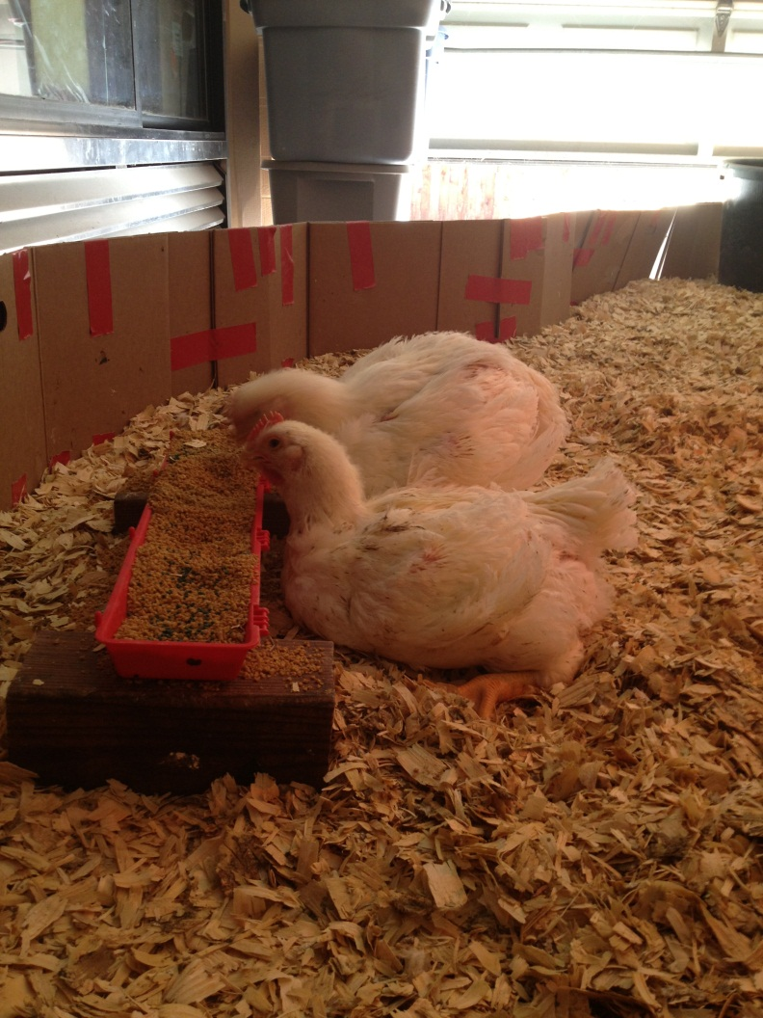
Week 5-6

Slide 10
Week 6-7

Slide 11
Show Broiler Project Information
Equipment Needed
Growing Space (garage, barn, Storage shed)
Feeders (Potted plant bottom, open pan feeders, PVC)
Waters (plasson plastic or galvanized 5-10 gallon water)
Elevators- Bricks or Chain to hang
Heating lamps
Fans and/ Window Units A/C
Wood Shavings (Not cedar) / Shavings Stir
Lights in Broiler pen
Food Scale (Bed & Bath)

Slide 12
Show Broiler Project Information
Length of Project
6-7 weeks
Cost
Chicks- $1.54 each ($101.54)
Feed – 12 lbs 42 days / feed/ bird @30 cents / lb- $3.60 a bird

Slide 13
Show Broiler Project Information
100 bird Example:
100 birds: 0-14 days – 1.5 lb feed/bird = $45 total feed
(1.5 LB X100birds X $0.30 LB )
50 birds: 15-28 days – 4 lbs feed / bird = $60 total feed
35 birds: 29-42 days – 6.5 lbs feed/bird=$68.25total feed
Total Cost Est- $173.25
Shavings- $80
Electricity- ?
Entry Fee- $10 a pen X 2 Pens = $20
TOTAL COST ESTIMATE- $375.00

Slide 14
Show Broiler Project Information
Feed
Purina Turkey Starter Purina Show Broiler
0-14 days – 100% Turkey Starter
15-21 days- 50/50
22-28 days- 25/75
29-42 days- 100% Show Broiler
Avg 12 lbs feed per bird within 42 day period
Water
Clean Water at ALL times*******

Slide 15
Show Broiler Project Information
Space
Starting out aim for 2 sq feet per bird
As you cull down to your 2 weeks, aim for 5 sq feet per bird
Culling
Cull by weight at 2.5 weeks. Cut birds in half. (100 down to 50)
Cull by keel length and breast width at 4 wks (50 down to 35)

Slide 16
Show Broiler Project Information
Final Selection
1 pen = 3 birds
You can show 2 pens of chickens at the county show
Day or Night before the show, select your pens of chickens. A pen is made up of 3 birds that are uniform in Breast meat Yield. The Bigger the better, BUT they all 3 must be uniform and match.
Pick a 4th bird for each pen as your alternate.

Slide 17
Show Broiler Project Information
Ventilation / Temp
90 degrees on floor 1st 5 days, reduce by 5 degrees each week until you hit 70 degrees at 4 weeks. Goal for temperature going forward is 58-70 degrees
Need air flow in broiler pen using fans and/or A/C.
Time
The more time you spend in the broiler pen the better. Movement will stimulate birds to move and eat and drink. The more times you walk in the pen and get birds up, the more they will eat and drink.
Stir, Stir, Stir, SHAVINGS…….This will keep your shavings clean and get birds up and moving around, eating, drinking.

Slide 18
Show Broiler Project Information
Capturing $ Back
100 birds (95% livability) = 95
14 days or 2 weeks- sell culls @ $2.00 each - $90 (45 birds)
4 weeks- sell culls @ $4.00 each- $60.00 (15 birds)
End of project- sell remaining 35 birds at $5.00 each- $175
$90 + $60+ $175 = $325
MAKE SALE- (not Guaranteed, suggested) (You will need to Pre Arranged buyers)
Grand- $3,500
Reserve- $2,000
Other- $400-$900

Slide 19
Show Broiler Project Information
Placing your order:
Contact Mrs. Schertz : stacy_schertz@allenisd.org by the end of the school day on September 27th and she will place the order for the birds at 3:30pm
Payment is required at time of order. (Please send the money to school with your student so I can place the orders)
Make Checks to: Ideal Poultry
$41.75 Per 25 Birds

